Slide 1
History of use of anesthesia at birth
Recommended reading:
“Deliver me from pain – Anesthesia and birth in America”
By Jacqueline Wolf

Slide 2
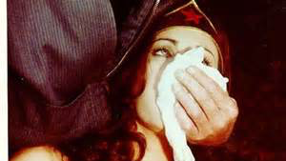
Ether and Chloroform

Slide 3
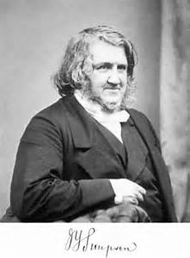
From 1840’s to the end of the 19th century
Moved from social birth (support by women) to physician attended birth at home
Doctors only attended difficult births called by midwives : difficult labors were very fearful
First used ether (produced lethargy, vomiting, hysteria). Simpson in Scotland found chloroform had less side effects, administered to queen Victoria in her 8th birth in 1853.
First was used for high society, but later on extended to charity hospitals.

Slide 4
When they were used
Mostly used in second stage labor since in the first part of labor would induce too much lethargy and weakened contractions.
Doctors had the perception that second stage (pushing) was extremely painful that is why they medicated it but women often report that they don’t feel it so much, behavior is involuntary.
Reports by women using ether and chloroform how heavenly it felt, no pain etc. Women asked for them and if doctors wouldn’t provide they went to other doctors.

Slide 5
Side effects
Side effects of chloroform: patients preferred chloroform because it acted more quickly, they needed less, it was cheaper, smell didn’t linger, irritated less the throat and lungs. Later evidence of causing liver damage and sudden death. Later discovered also causing postpartum hemorrhage, diminished contractions, increased need of use of forceps, weakening the heart. Only needed a handkerchief.
Side effects of ether: hemorrhage, irritate lungs, damage kidney, slow contractions, asphyxiate the baby . Ether required equipment.

Slide 6
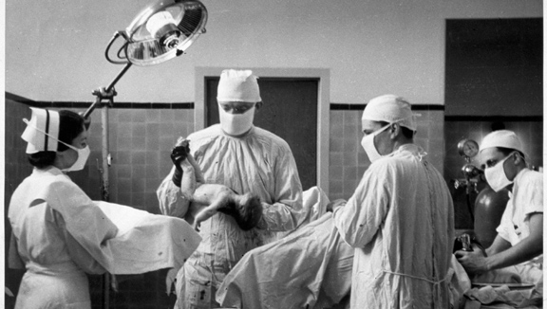
Twilight sleep: 1900’ to 1930’

Slide 7
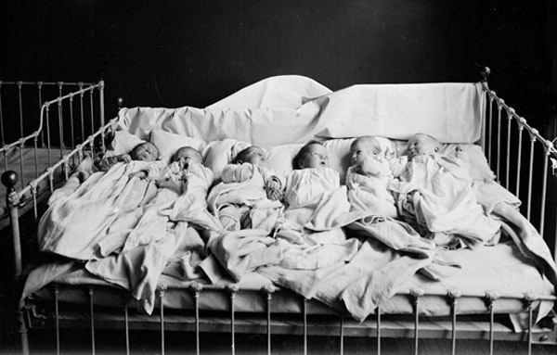
Scapolamine and morphine
Combination of scopolamine (amnesic) and morphine (narcotic/ opiate, for pain). First injection often only morphine. Memory test for further injections.
First used in 1902 in Freiburg, Germany. Attentive nurses and doctors, babies away from 10 pm on to 10 am. Wet nurses if needed. High class. Physicians thought refined women could not withstand labor pain.
Women will feel pain but will not remember it.

Slide 8
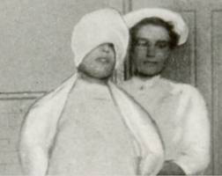

Unpleasant side effects
Prolonged labor, slowed pulse and uterine contractions, headaches for days, dry throat, more use of forceps and hemorrhages; decreased respiration for baby, babies blue after birth; restlessness and delirium, even violence.
Most patients were submissive but some were yelling, bolting and moving like caged animals. They built canvas cages. Amnesia no need for comfort and companionship. Isolation, easy to ignore suffering.

Slide 9
How it became popular
American physicians rejected it at first. But women’s magazines presented to the public as the best new discovery so doctors had to reevaluate.
It didn’t have the unpleasantness of ether or chloroform: no odor, no mask, no suffocating feeling, stupor.
Instead the whole birth was a blank. They advertise women would recover very fast, and will have healthier babies.
Magazines, even socialist where asking twilight sleep for all women, not just the rich. Fight for it. Public put a lot of pressure on doctors, and these changed their mind.
In order to gain respect and keep clients, doctors had to provide twilight sleep.
Public interest and demand for twilight sleep lasted only 15 months but doctors continued using it sometimes until the 60’. Often doctors would combine scopolamine with demerol or other drugs later on.

Slide 10
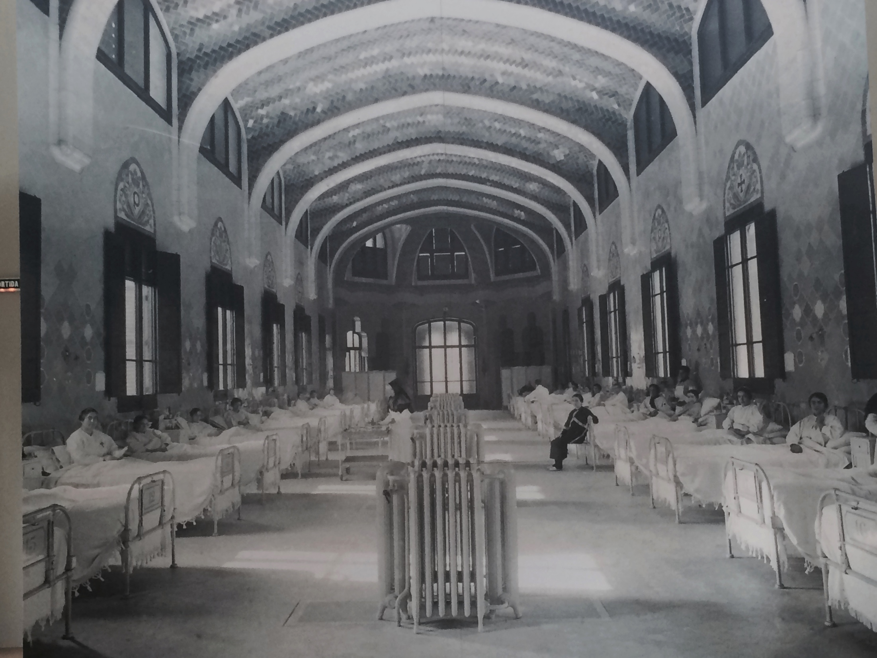
Anesthesia arsenal 1900’ to 1960’
The use of anesthesia invited the use of forceps and more hemorrhages and lacerations.
The use of anesthesia was inviting women to hospitals, and there they would deliver in common wards where they preferred to use anesthesia not to be present to other women’s births.
1900, 5% birth at hospital
1939 half of all births and 75%
of urban birth at hospital
1955, 95% at hospitals

Slide 11
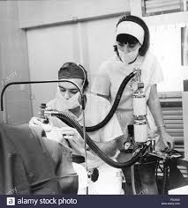
Chain of interventions
Between 1920’ and 45’ development of all kinds of drugs injected, inhaled, administered orally, IV, rectal etc.
In the 40’ and 50’ most women received anesthetics: heavy analgesia or morphine in first stage labor and inhalation anesthesia in second stage (chloroform at home, and ether or Nitrous Oxide at the hospital); or general or regional anesthesia during second stage, routine episiotomy and forceps.

Slide 12
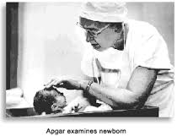
Dangers of using drugs at birth
Doctors started to realize that the more interventions the less safe. Many babies needed resuscitation.
Virginia Apgar is the first doctor that proved that analgesia and anesthesia crosses the placenta. Apgar score created in 1952. 5 signs: Pulse (heart rate), respiratory effort, response to stimulation, muscle tone and color. Each sign a score from 0 to 2. Less than 4 demands resuscitation.
Despite the studies, the use of anesthesia/analgesia continued. Women would speak well about the heavily drugged births because they didn’t recall all that they went through.

Slide 13
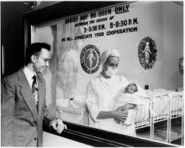
Giving birth to the baby boomers 40’ to 60’
Common practices/routine: Labor induction (or at least augmented): castor oil enema. Saving of the pubic hair, Then injection with sedatives/analgesics in stage one, then general or regional (saddle block) anesthesia for second stage of labor. Then episiotomy then forceps. Unconscious for 12 hours, and in bed 5 to 10 days after birth. Mom and baby in different rooms. Nurses will bring babies every 4/5 hours for nursing during the day.

Slide 14
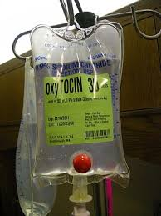
Induction for convenience
Pitocin and anesthesia go hand in hand: fast and strong contractions with Pitocin require the anesthesia.
Induction for convenience was controversial (although used) but augmentation of labor with Pitocin to speed it up was well accepted in the 40’. Analgesia could be administered at the same time with Pitocin to avoid the pain of contractions.
Births by appointment.
Birth nearly doubled from the 30’s to the 50’s from 2.5 to 4.5 millions in the US.

Slide 15
Start to backlash
Hospitals developed their own regime, not uniformity over the country.
They used barbiturates to sedate, opiates for pain and scopolamine to erase memory.
Start to backlash: some doctors started to protest for the side effects: more child retardation, death as result of induction, apgar had discovered already that medication crosses the placenta, practices inhumane for women, natural birth by Dick-Read (started on the 30’) but became known in women magazines in the 50’ and 60’ in the US.
Early 70’ women started to rebel to dangerous and unnecessary medical routines. They reclaimed birth.

Slide 16

Natural Birth 50’s to 80’
Ina May Middleton is one of the key figures. Her first birth was hospital (Demerol, spinal, forceps, episiotomy). She married Stephen Gaskin, teacher, and settled in Tennesse in a big land, the “Farm”. Famous Midwifery Center
The question of authority and the dissatisfaction with medical profession grew through the years in 50’s and 60’s.
Women movement demanded changes in hospital practices (nurses paid attention to machine not to laboring mothers).
By early 80’s birth reformers had achieved tangible success: like “personalized birth plans” with options of presence of siblings and partners at hospital birth, music, own pajamas, filming, dimmed lights, using birthing chair etc. Minimal offering was a private, cozy room to labor, deliver and recover (LDR room) with rooming in (keeping mother and baby together). Late 70’s father attended birth become universal.

Slide 17

Dick-Read,Lamaze and Bradley
Two obstetricians: Grantly Dick-Read in England and Fernand Lamaze in France support natural birth (from 40 and 50’s)
Dick-Read talks about the importance of cheering counsel, and no fear. developed a method that included relaxation, breathing, squatting, pelvic rocking.
Lamaze developed his method 15 years later, Slow breathing during first stage and rapid breathing second stage, and panting during birth.
Robert Bradley, American obstetrician in Colorado developed the “Husband coached childbirth” . he taught men to help their wives relax through first stage contractions with soothing instructions and comforting mental imagery.

Slide 18
Backlash
Painless Childbirth by Lamaze… created unrealistic expectations of no pain at all… this brought disappointment and ridicule.
The same magazines that said natural birth was beneficial in the 70’s, denounced it as unreasonably demanding and dangerous in the 90’s.
Hospital took over childbirth education in the 80’s as ways to acclimate women to hospital protocols and treatments. Hospital would offered a Lamaze approach that supports the benefits of medication and medical protocols.

Slide 19

Epidural Anesthesia Popularized in the 70’s- Preferred choice since the 90
*A hollow needle and a flexible catheter is inserted in between the spinal cords outer membrane and the spinal column (within the lower or middle back). The needle is then removed and the catheter stays to provide constant anesthesia.
* Local anesthesia such as bupivacaine or lidocaine. Often combined with opioids like fentanyl and sufentanil to decrease the dose of local anesthetic.

Slide 20
Cascade of interventions
*Choice at birth is not really choice anymore since nurses are not used to deliver natural births. So choice nowadays is acceptance or rejection of three routine treatments: labor induction, epidural anesthesia and cesarean section.
In a single generation the predominant portrayal of ideal birth had gone from invigorating, spontaneous, fully felt event to a carefully scheduled, fully numbed, non taxing event. Epidural anesthesia is the norm.
Young women glorify anesthesia like their grandmothers. Fear of pain.

Slide 21
Correlation drugs at birth and later on in life Case Study Karolinska Institute
In a well-designed case control study at the Karolinska Institute in Stockholm in 1990, researchers compared children exposed to pain relieving drugs in labour with those who were not and discovered an increased risk of drug addiction later in life (Jacobson et al., 1990).
In 1988 they showed that when nitrous oxide was given to the mother the child was five and a half times more likely to become an amphetamine addict than a brother or sister born to the same parents.
In their paper in the British Medical Journal(1990), patients who had died from opiate addiction were compared with brothers and sisters; the researchers found that if the mothers had been given opiates or barbiturates or larger doses of nitrous oxide the risk of opiate addiction to the child in later life was increased 4.7 times.

Slide 22
In a further study, researchers discovered that the risk of drug addiction was related to the hospital in which they were born. In other words, the likelihood of a child developing drug addiction in later life depended on the labour ward policies of the hospital the mother chose for the birth,
"For the amphetamine addicts, hospital of birth was found to be an important risk factor even after controlling for residential area" (Nyberg, 1993).
Jacobson and Nyberg’s research suggests that the use of opiates, barbiturates and nitrous oxide in labour causes imprinting in the babies, and we are now reaping the whirlwind.

